Slide 1
Feedback on user research findings
24th April 2023

Slide 2
Agenda
14.00 Welcome
14.05 Housekeeping
14.10 Introduction to the project
14.20 Methodology overview
14.40 User archetypes
15.05 Break
15.10 User needs and challenges
15.35 How might DSH help you?
15.50 Close

Slide 3
Community code of conduct
Open Data Manchester is an inclusive community. Everyone is welcome.
You are free and encouraged to share your ideas, contribute to discussions, agree or disagree.
Everyone should be allowed time and space to speak without interruption.
Not everyone feels confident enough to speak up, particularly in larger groups. Be mindful of those who haven’t contributed and give them space to speak if they wish.
At the same time, not everyone feels comfortable speaking in public and that’s also OK.
If you cause anyone to feel unwelcome or unsafe, you will be asked to leave.
We welcome suggestions from you about how we can improve our events.
Full code of conduct, including Community Custodian details at: https://bit.ly/ODM-CCC

Slide 4
Introduction to DSH
Richard Kingston - University of Manchester

Slide 5
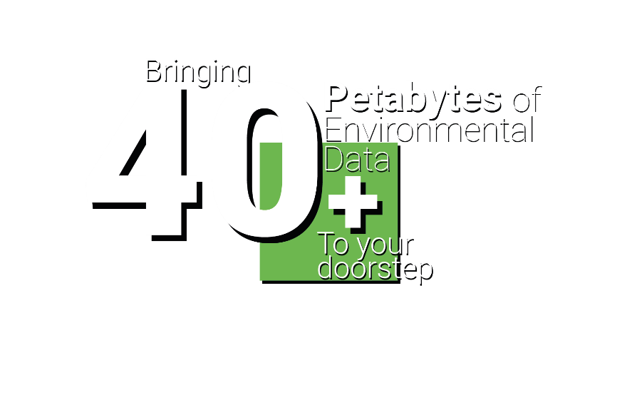
The Digital Solutions Hub Why we are here today?
DIGITAL SOLUTIONS HUB
digital-solutions.uk
@nercdsh

Slide 6
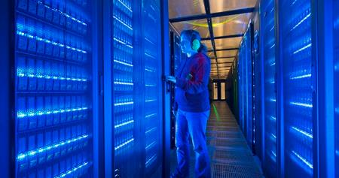
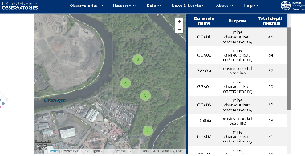
NERC Digital Solutions Programme
5 year £8m investment to build a UKRI ‘national facility’ – the Digital Solutions Hub – during phase 1
NERC’s core focus is to work closely with stakeholders across the public / third sector and industry
plus those of you who are not environmental scientists in academia
making NERC’s 40+ PBs data more discoverable to non-academic users
to make better use of their data from the 5 data centres
connecting with social, economic, health and other environmental data across the whole of the UK
integrated with JASMIN for analytics and modelling
Post 2025 – phase 2 funding

Slide 7
(previously PHE)
Notes:
This only captures a fraction of our engaged partners.

Slide 8
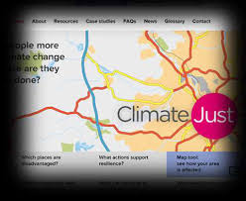
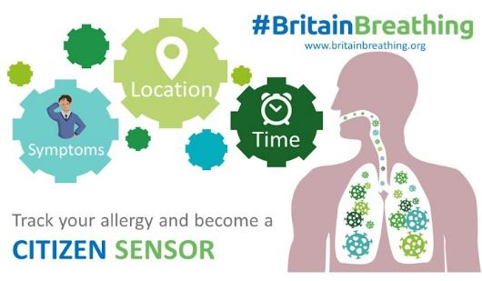
A user-centric digital solution – builds on our existing expertise at the University
A Climate Ready Nation
www.climatejust.org.uk
urbanobservatory.manchester.ac.uk
A Connected Health Nation
britainbreathing.org
www.cloudywithachanceofpain.com
These are just a few examples of things we have built in the past which make use of some of NERC’s data.

Slide 9
Participant Consent Form
We need you to fill in the form
well email this to you and also post it in the chat, you can then return it to digital-solutions@manchester.ac.uk
If you want to stay involved after today please tick either or both of the following two options:
I am happy to be contacted after the workshops for follow-up interviews
I am happy to be contacted after the workshops for user testing

Slide 10
Our user research methodology
Julian Tait - Open Data Manchester

Slide 11
Research objectives
Who would be the users of DSH?
What are they trying to achieve through using environmental data?
What are the processes used and challenges they faced when using environmental data?
What might the ideal solutions for the use and sharing of environmental data be?
These questions are not unique for the design of DSH!

Slide 12
User research process
Structured user research process over a period of 12 months

Slide 13
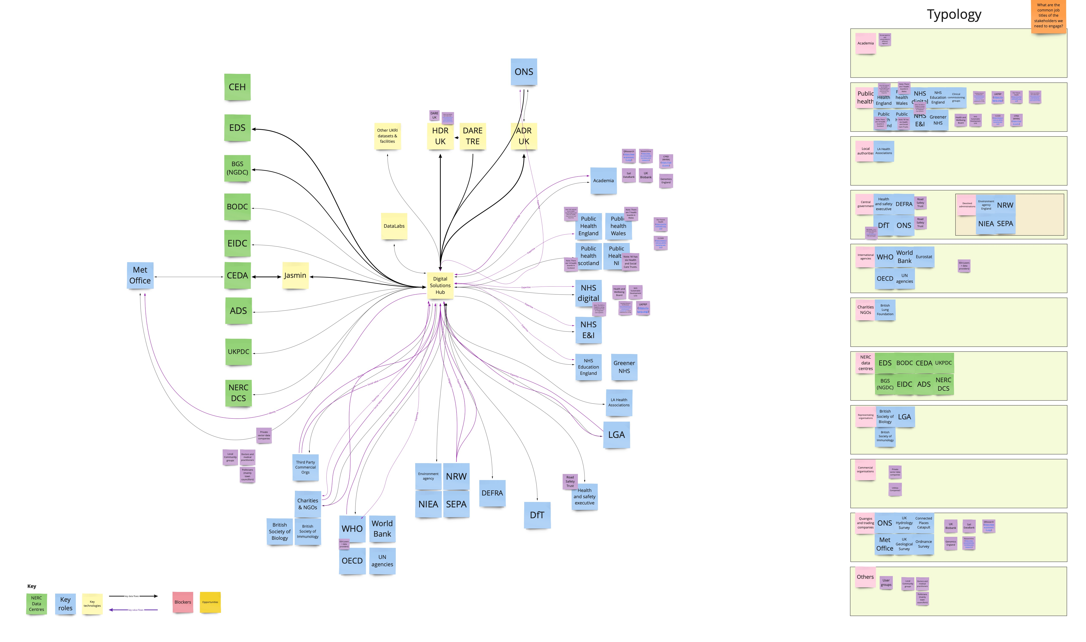
Stakeholder identification

Slide 14
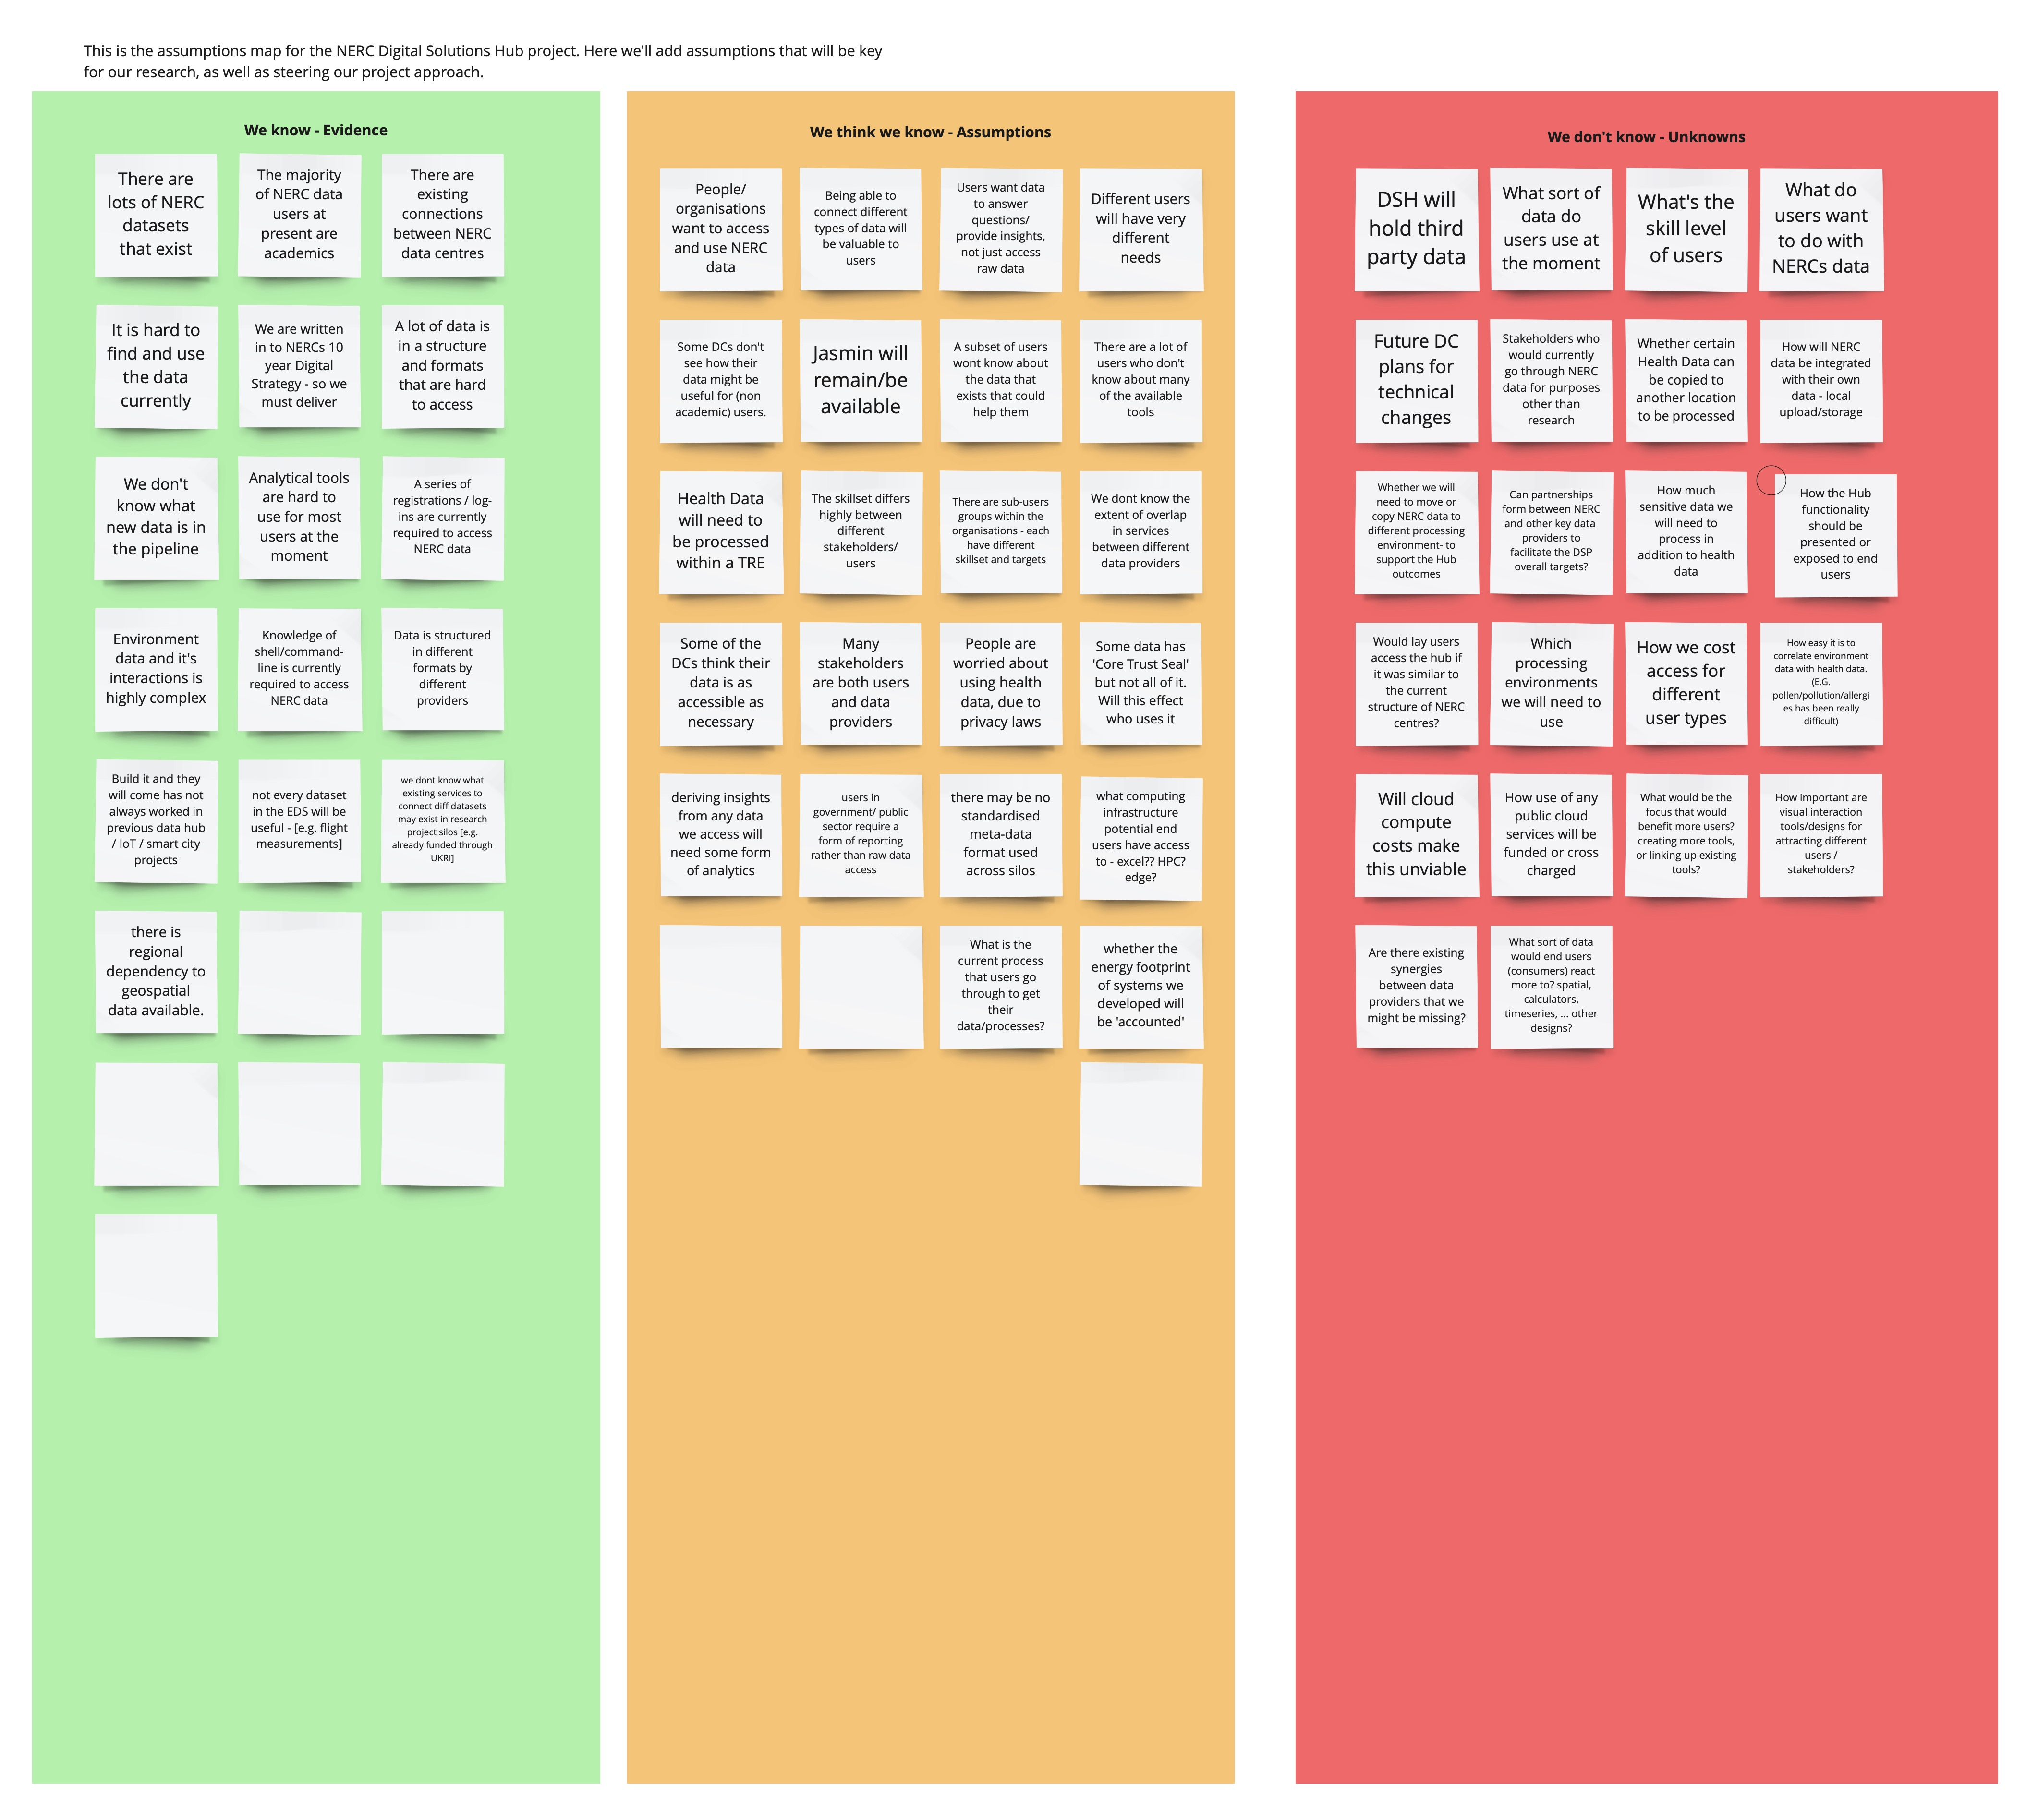
Mapping assumptions

Slide 15
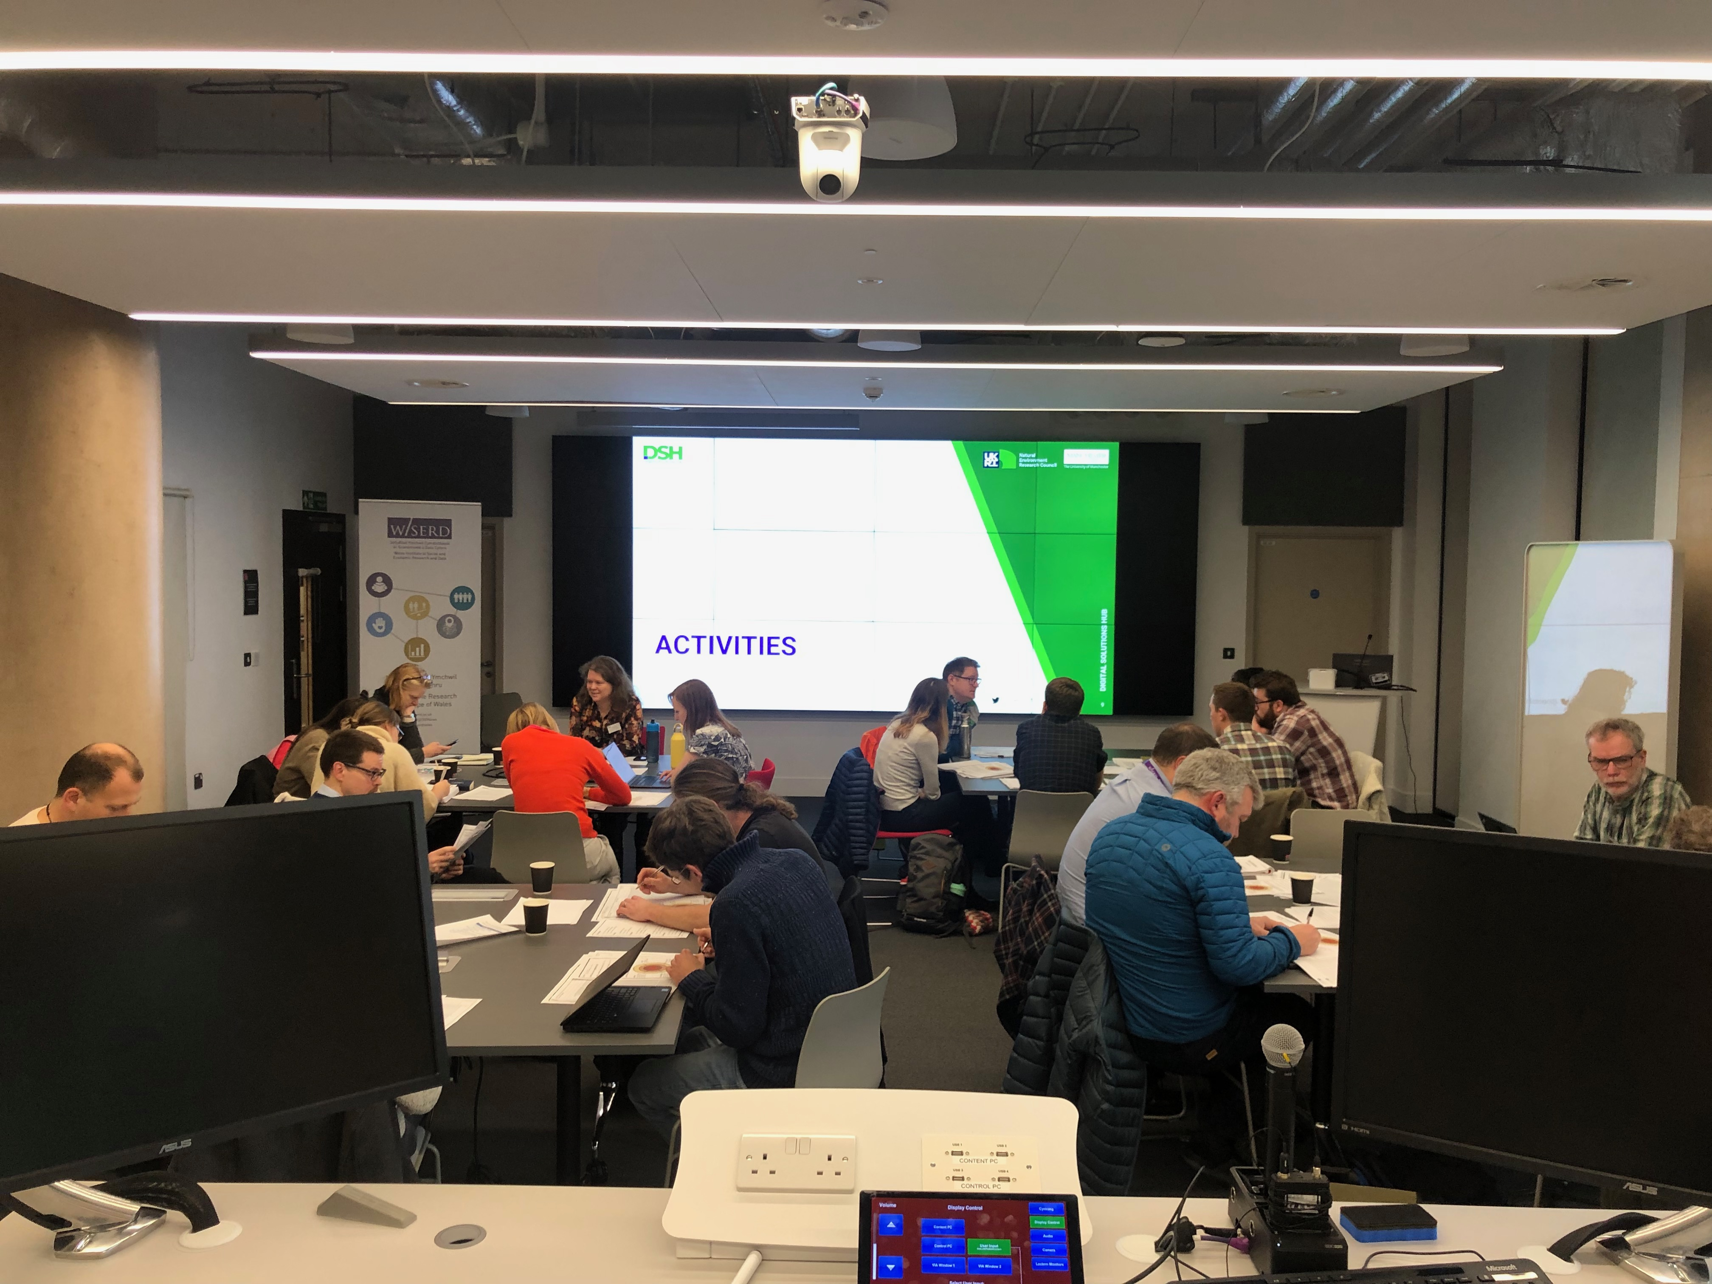
Workshop programme
Jul - Sep 22
Oct 22
Nov 22 - Feb 23
Apr 23
Online user research design workshops
User research prototyping workshop (Manchester)
User research workshops (Leeds, Newcastle, Plymouth, Bristol,
Southampton, Norwich, London, Glasgow, Belfast, Cardiff and
Birmingham
Feedback initial research findings

Slide 16
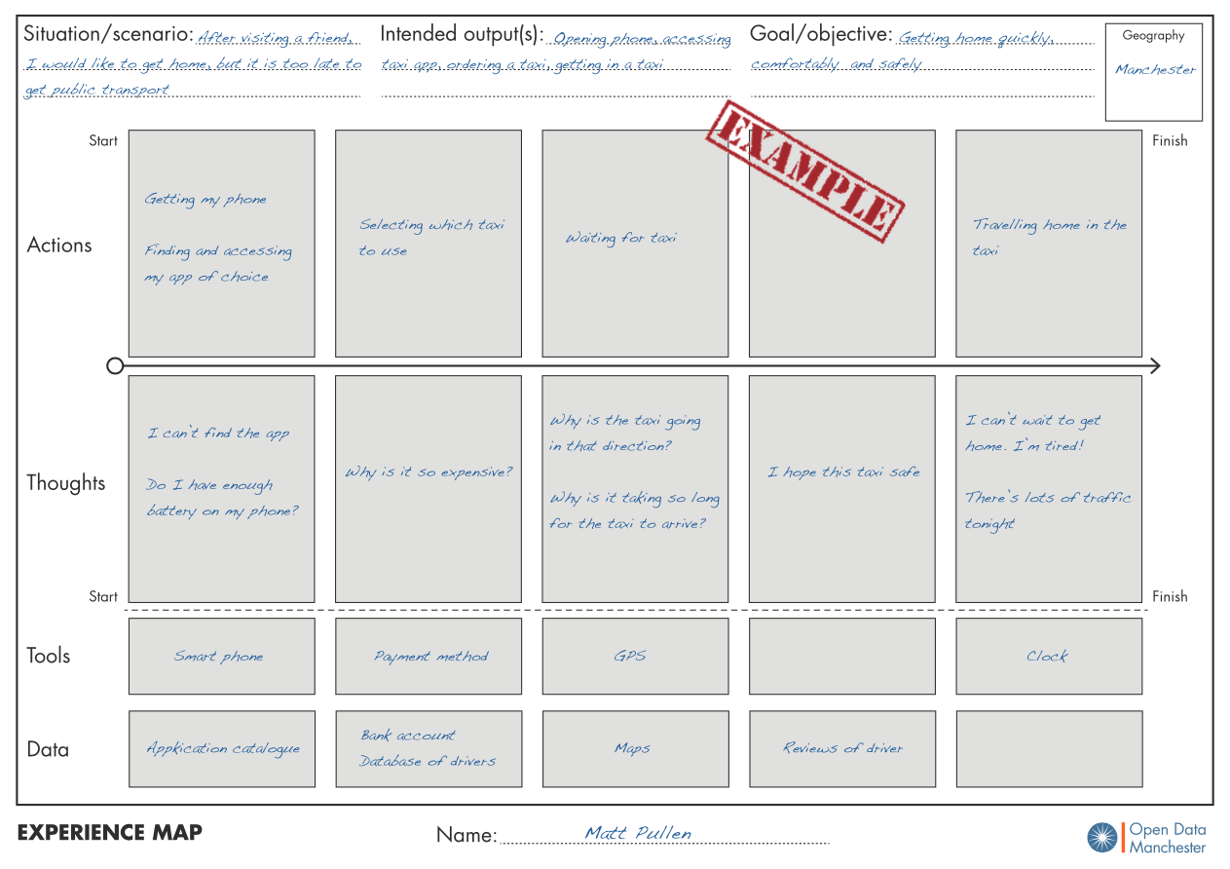
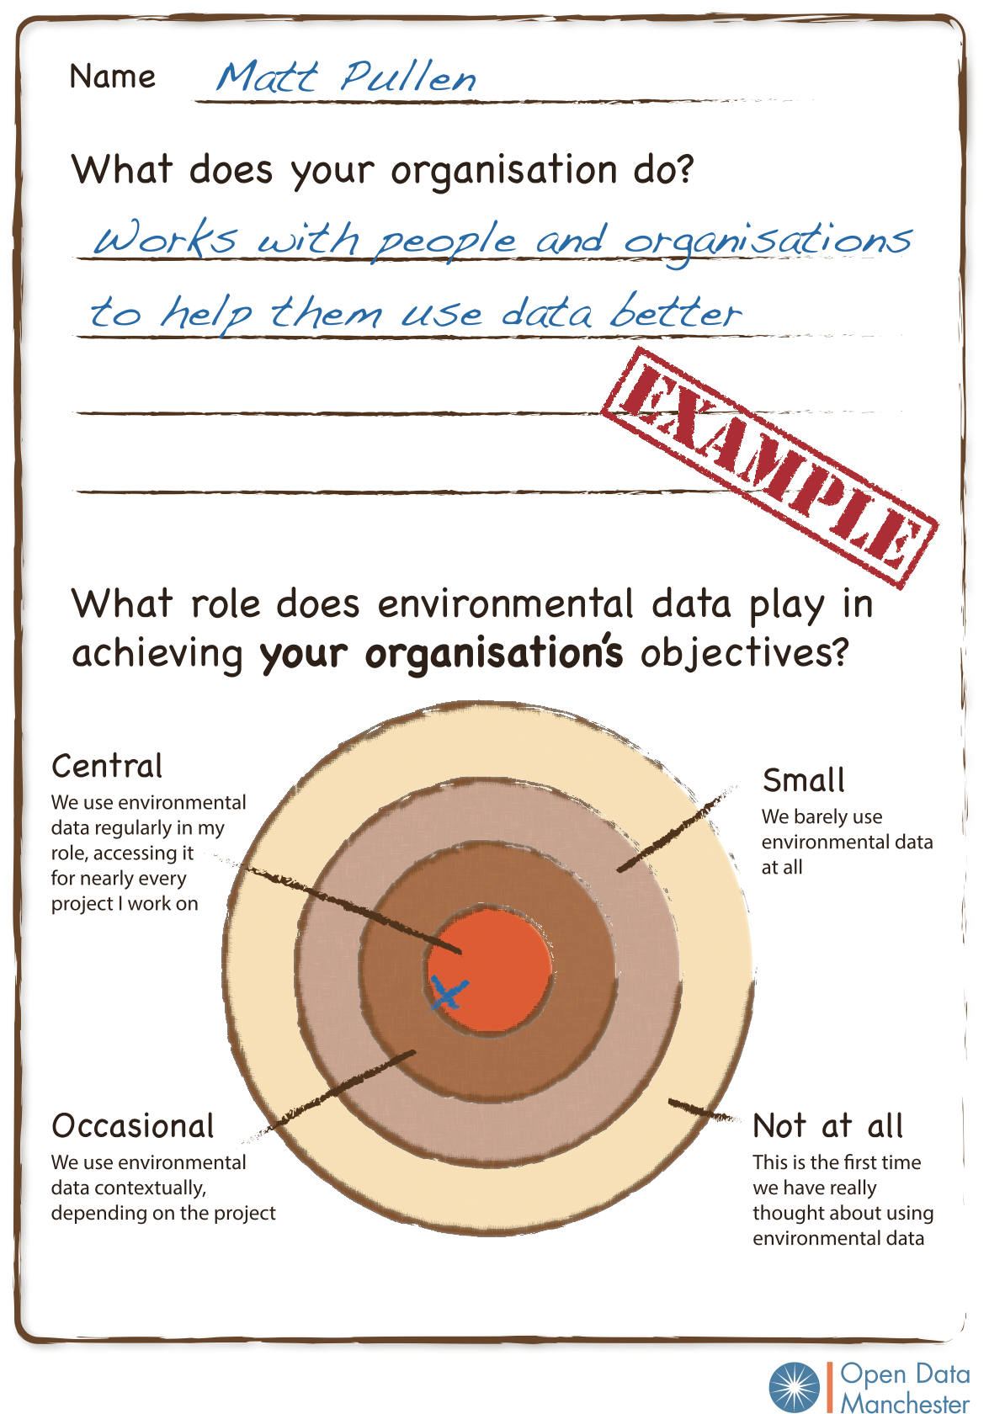
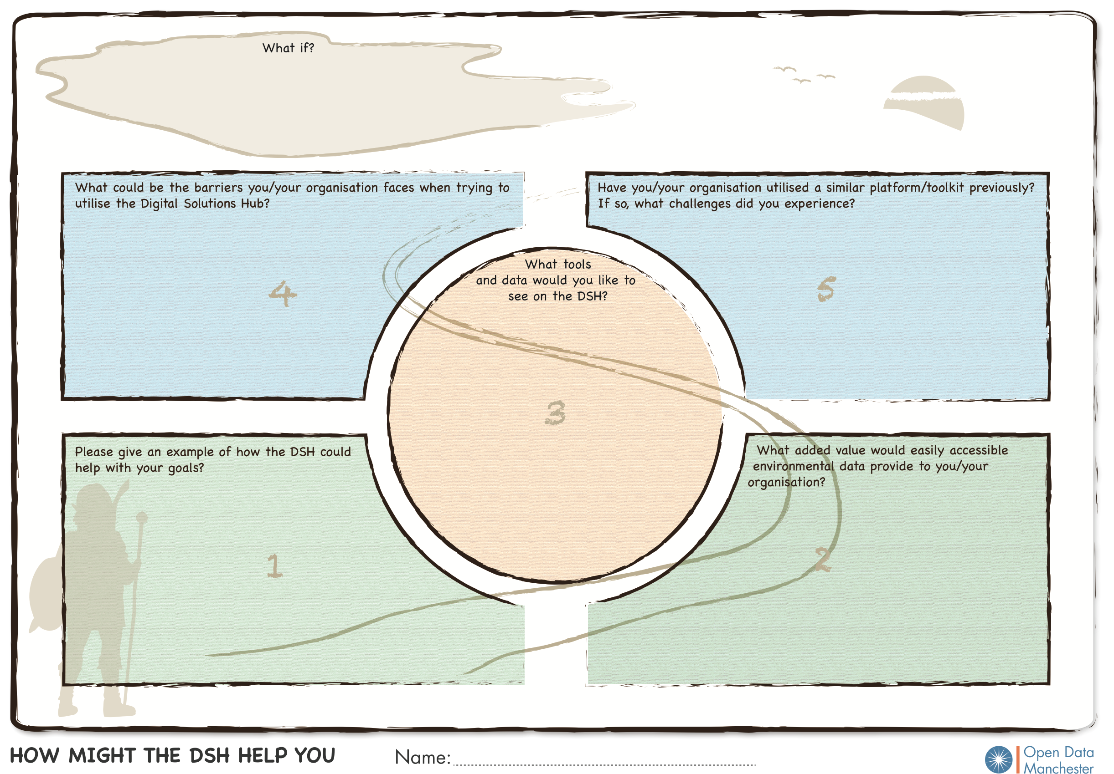
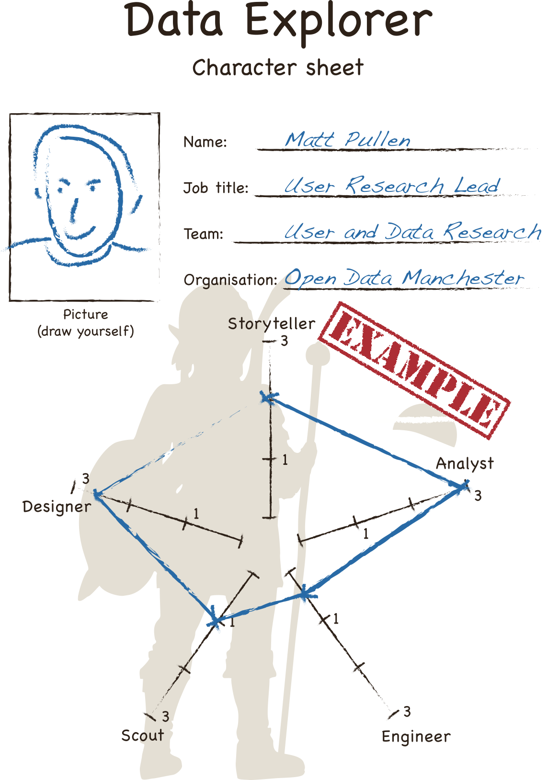
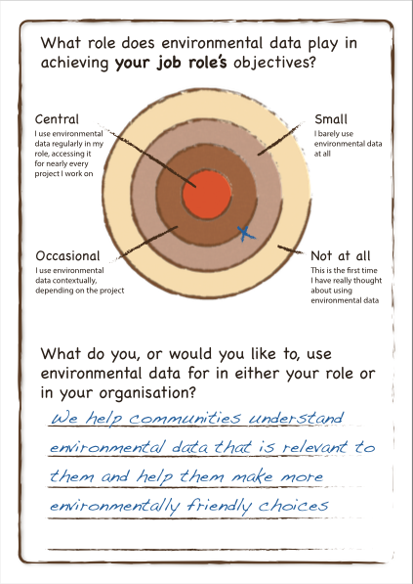
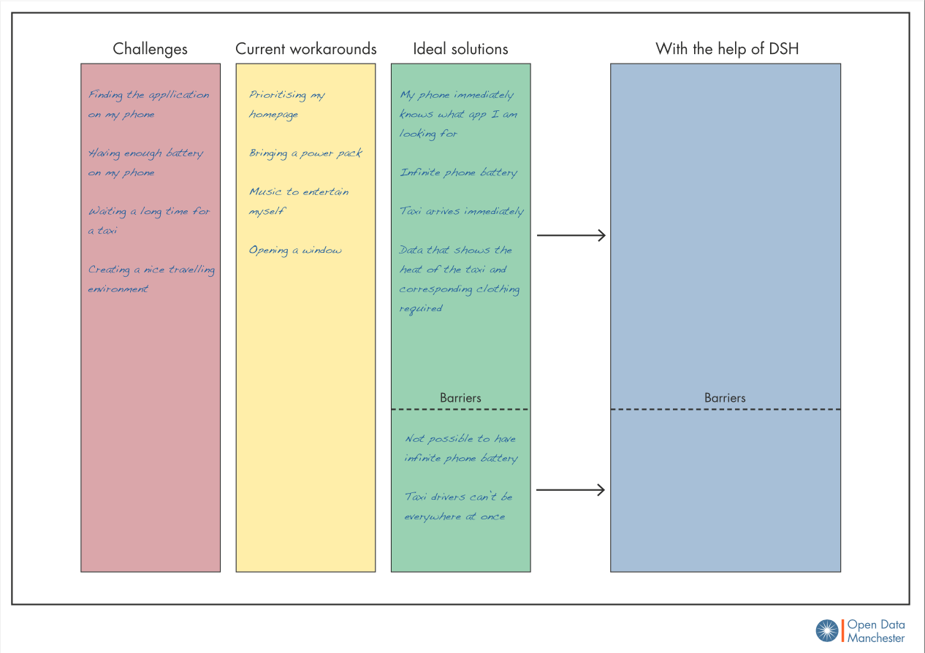
Workshop process

Slide 17
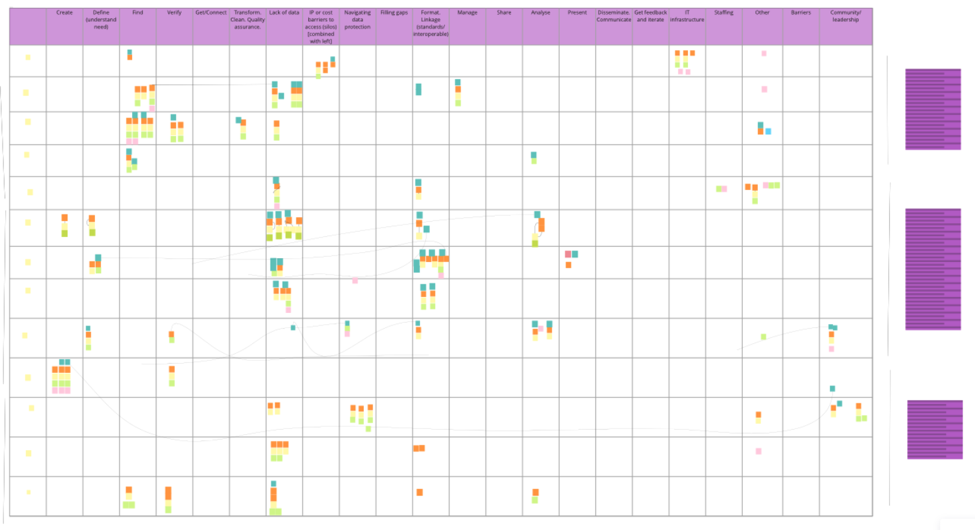
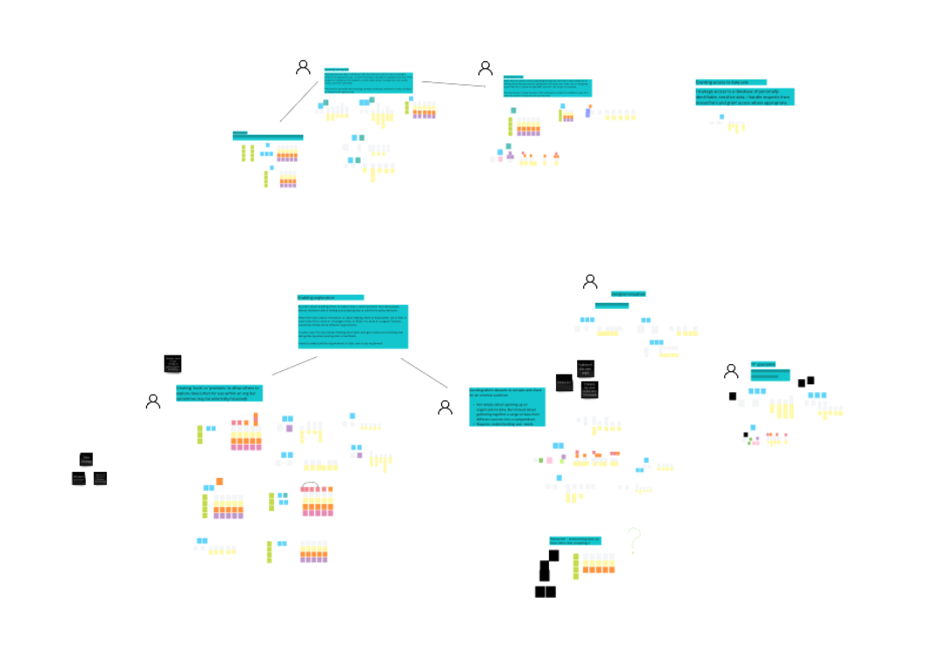
Synthesis

Slide 18
Archetypes
Mat Basford - Open Data Manchester CIC

Slide 19
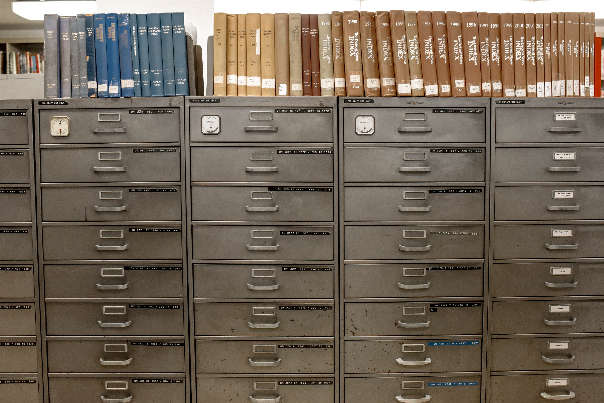
Slide text
Slide text
Archetypes
Notes:
Ways we’ve cut up a broad group of users, based on who we spoke with.
Focussed on activity rather than topic or organisation.
Missing – public, IT specialists, stakeholders

Slide 20
Analysts Monitoring
I need to use data to demonstrate the condition of the environment in a consistent format that will allow the heath of the environment, and the performance of environmental policy, to be scrutinised over time.
https://www.pexels.com/photo/white-10-feet-steel-tape-162500/
Notes:
Standardised approach to report and share data.
More might be done to share underlying data, and link different data together.

Slide 21
Designers of Monitoring
I need to identify measures of environmental health to use for scrutinising and evaluating policy, and informing future decisions.
https://www.pexels.com/photo/abstract-bright-close-up-color-268460/
Notes:
More about understanding and exploring, challenges around discovery
Responsibility for commissioning gathering and data management

Slide 22
Data Support
I need to support others to more readily explore data and obtain useful insights. I compile data and create data products that allow others to readily explore information relevant to their needs.
https://www.pexels.com/photo/adult-background-ball-shaped-blur-220147/
Notes:
Navigating asks/understanding need
A lack of data
Promoting outputs. Is there duplication?

Slide 23
GIS Specialists
I need to create data products that allow my intended audience to readily comprehend and explore information that is relevant to their needs, using map based formats.
https://www.pexels.com/photo/australia-map-68704/
Notes:
Resolution a major challenge
Iterative, test out easily rather than huge datasets

Slide 24
Analysts Identifying Correlations and Making Predictions
I need to find and analyse data to identify correlations and make predictions about the likely impact of actions.
https://www.pexels.com/photo/person-holding-pen-pointing-at-graph-590020/
Notes:
Biggest group:
Government, restrictive IT
Public health – timely access, and accidental disclosure
Academic – relationships to find and then promote

Slide 25
Data Leaders
I need to make sure my organisation is working effectively with data.
https://www.pexels.com/photo/paper-boats-on-solid-surface-194094/
Notes:
Patchy data landscape and trying to prioritise
Concerns about duplication in system

Slide 26
Data Governance Managers
I need to ensure datasets I have responsibility for meet appropriate standards, and are appropriately stored, shared, and kept up to date.
So that they can be readily discovered and used by others.
https://www.pexels.com/photo/gray-steel-file-cabinet-1370294/
Notes:
Incomplete picture of needs
Enforcing timely access and standards
Working across systems

Slide 27
Your Questions and Feedback...

Slide 30
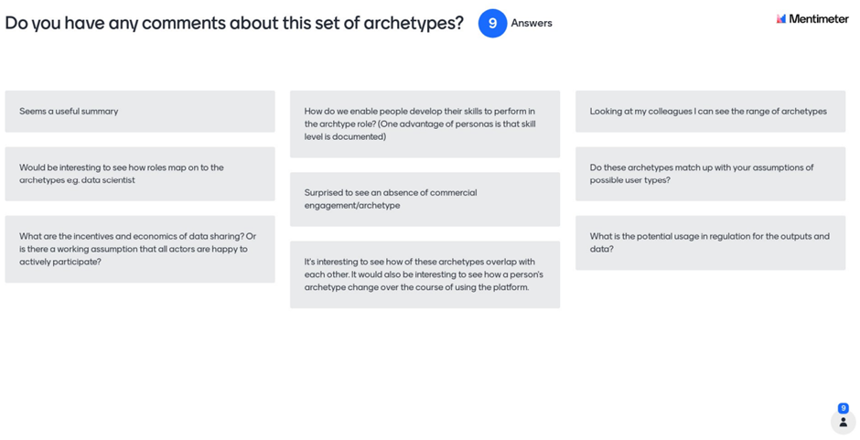

Slide 31
User Journeys
Sophie Walker - Open Data Manchester CIC

Slide 33
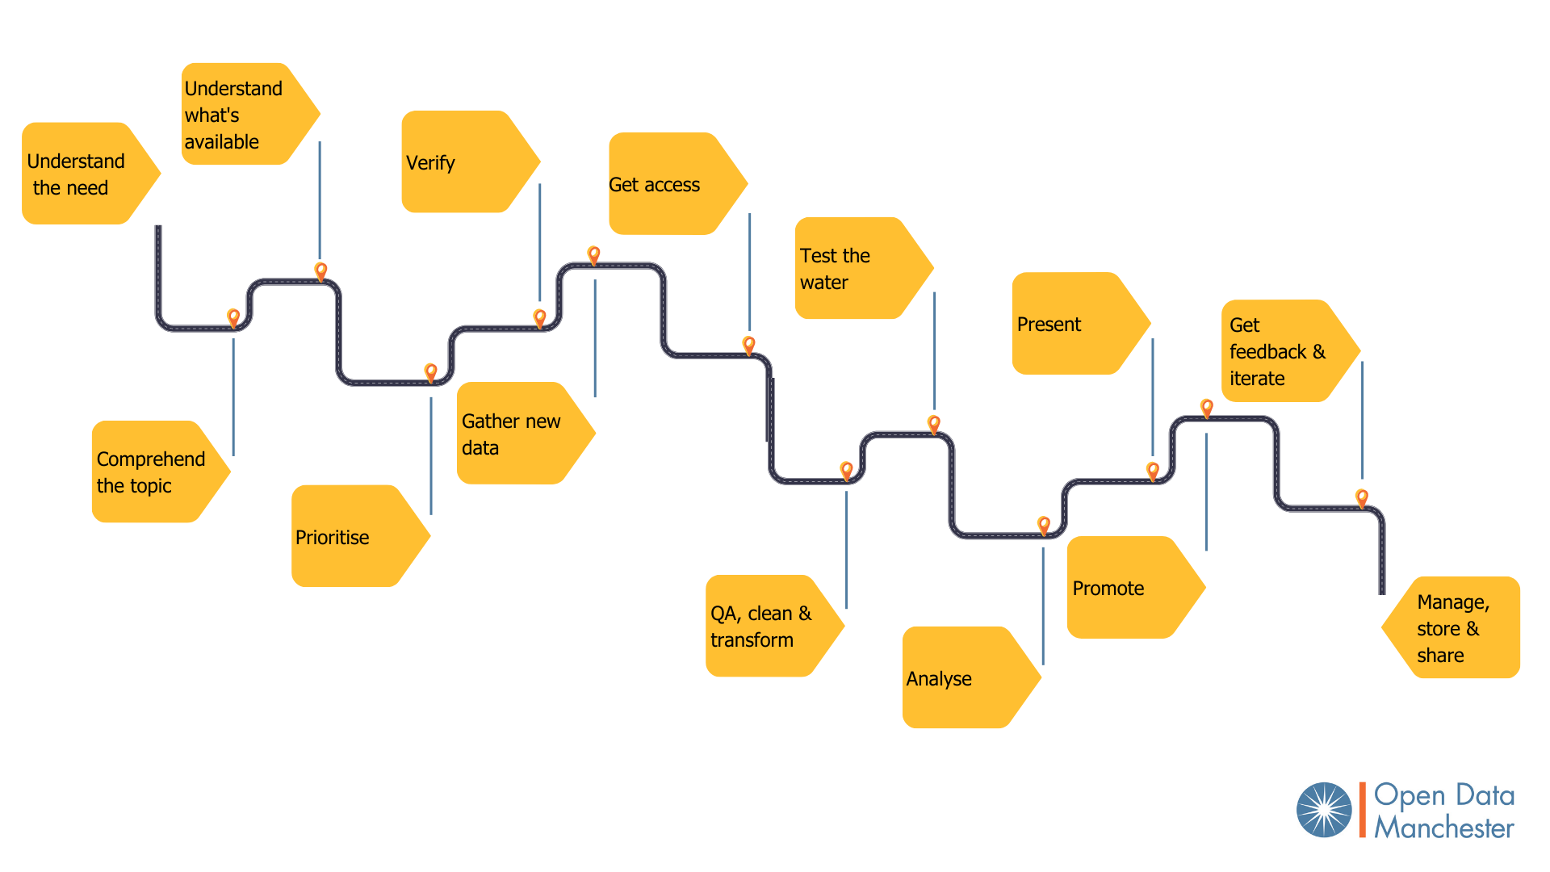

Slide 34
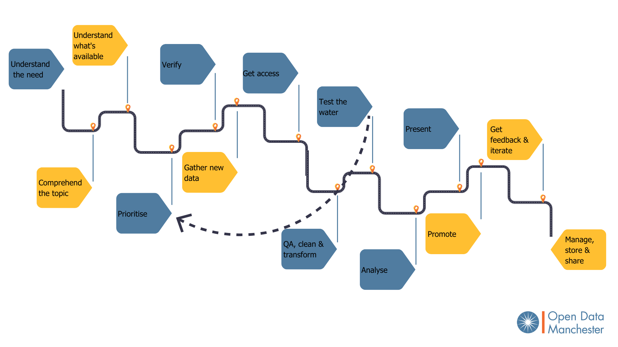

Slide 35
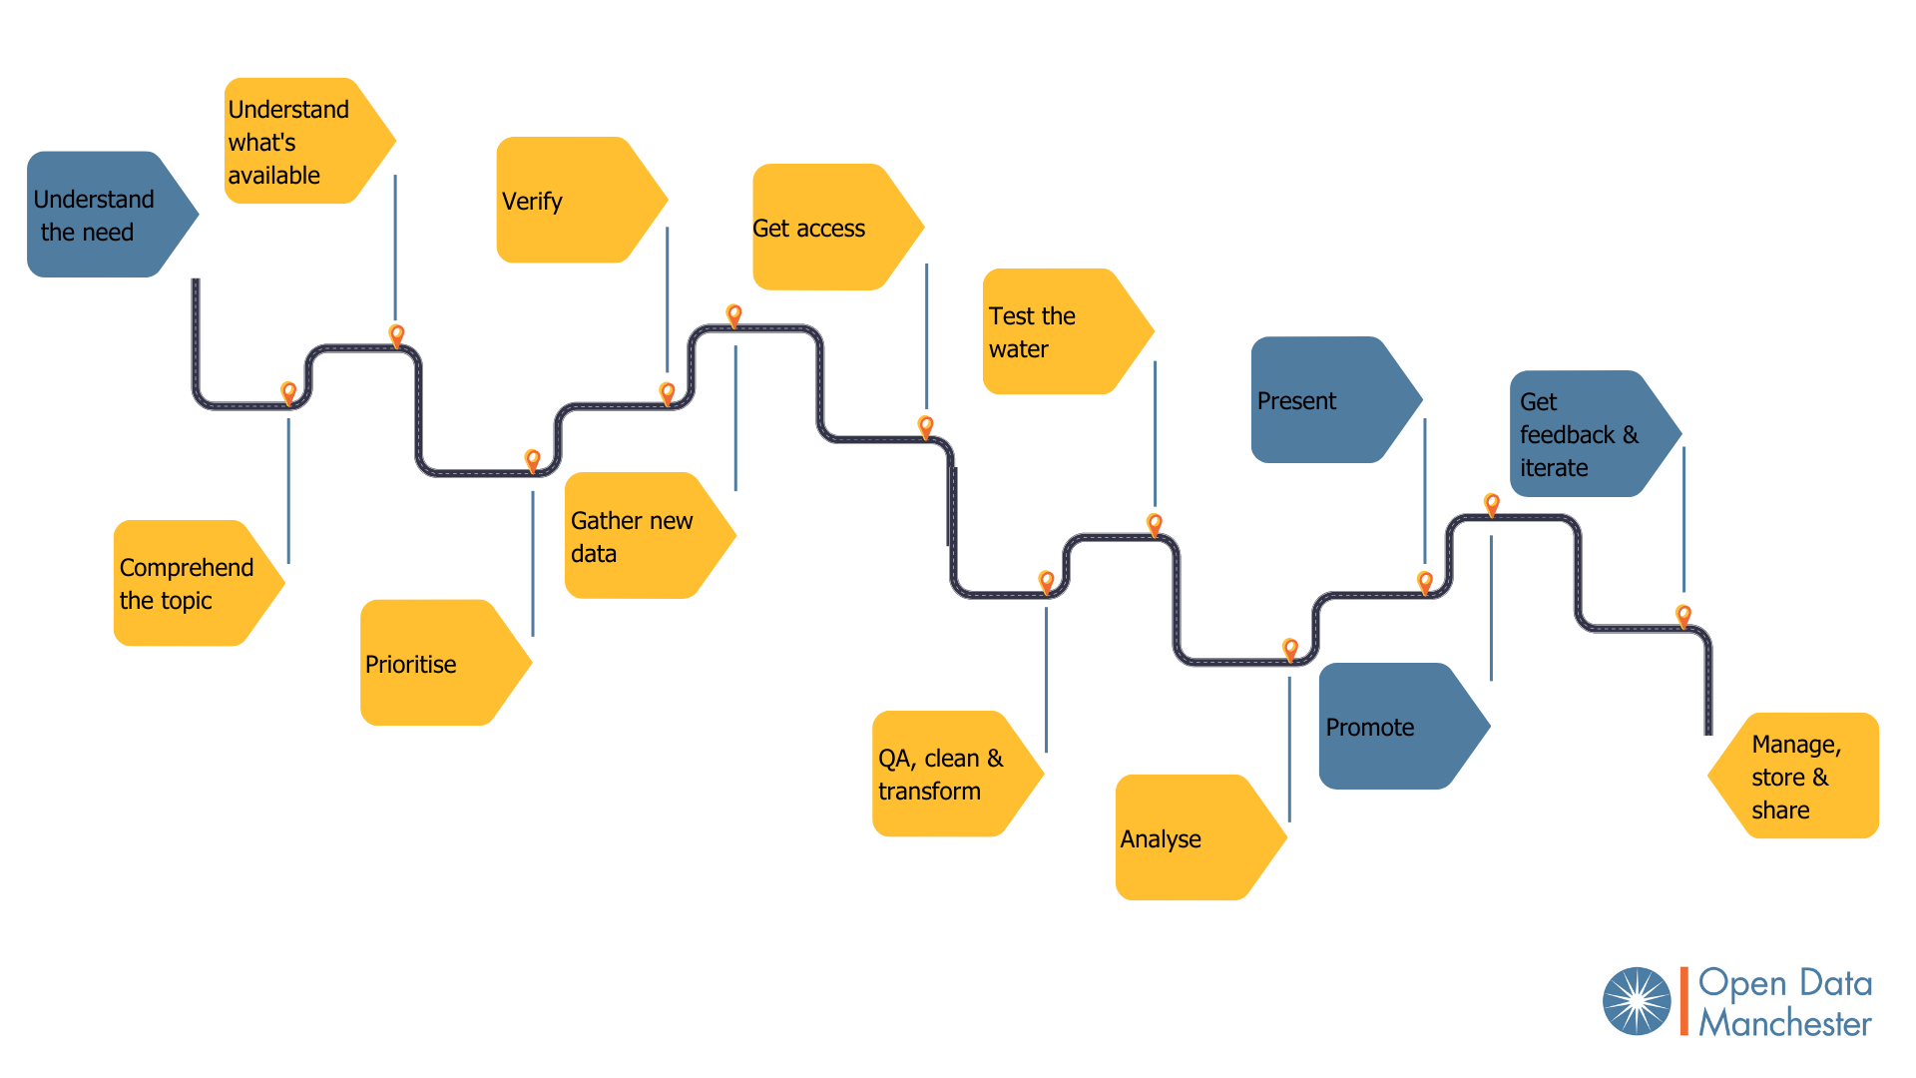

Slide 45
